Slide 1
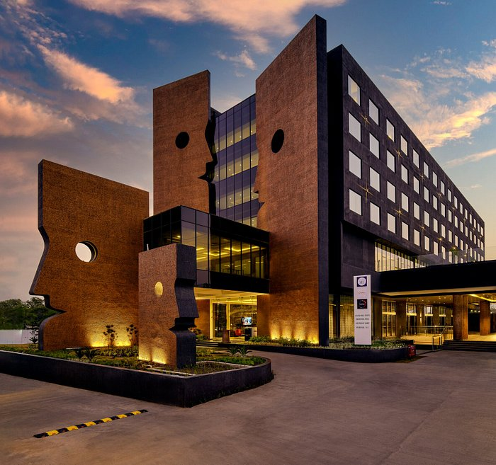
Hotel management system
(Presented by Group-D)

Slide 2




Team members
MUHAMMAD TALAL
ABDUL REHMAN
ZAIN UL ABDEEN
RAMISH BASHEER

Slide 3
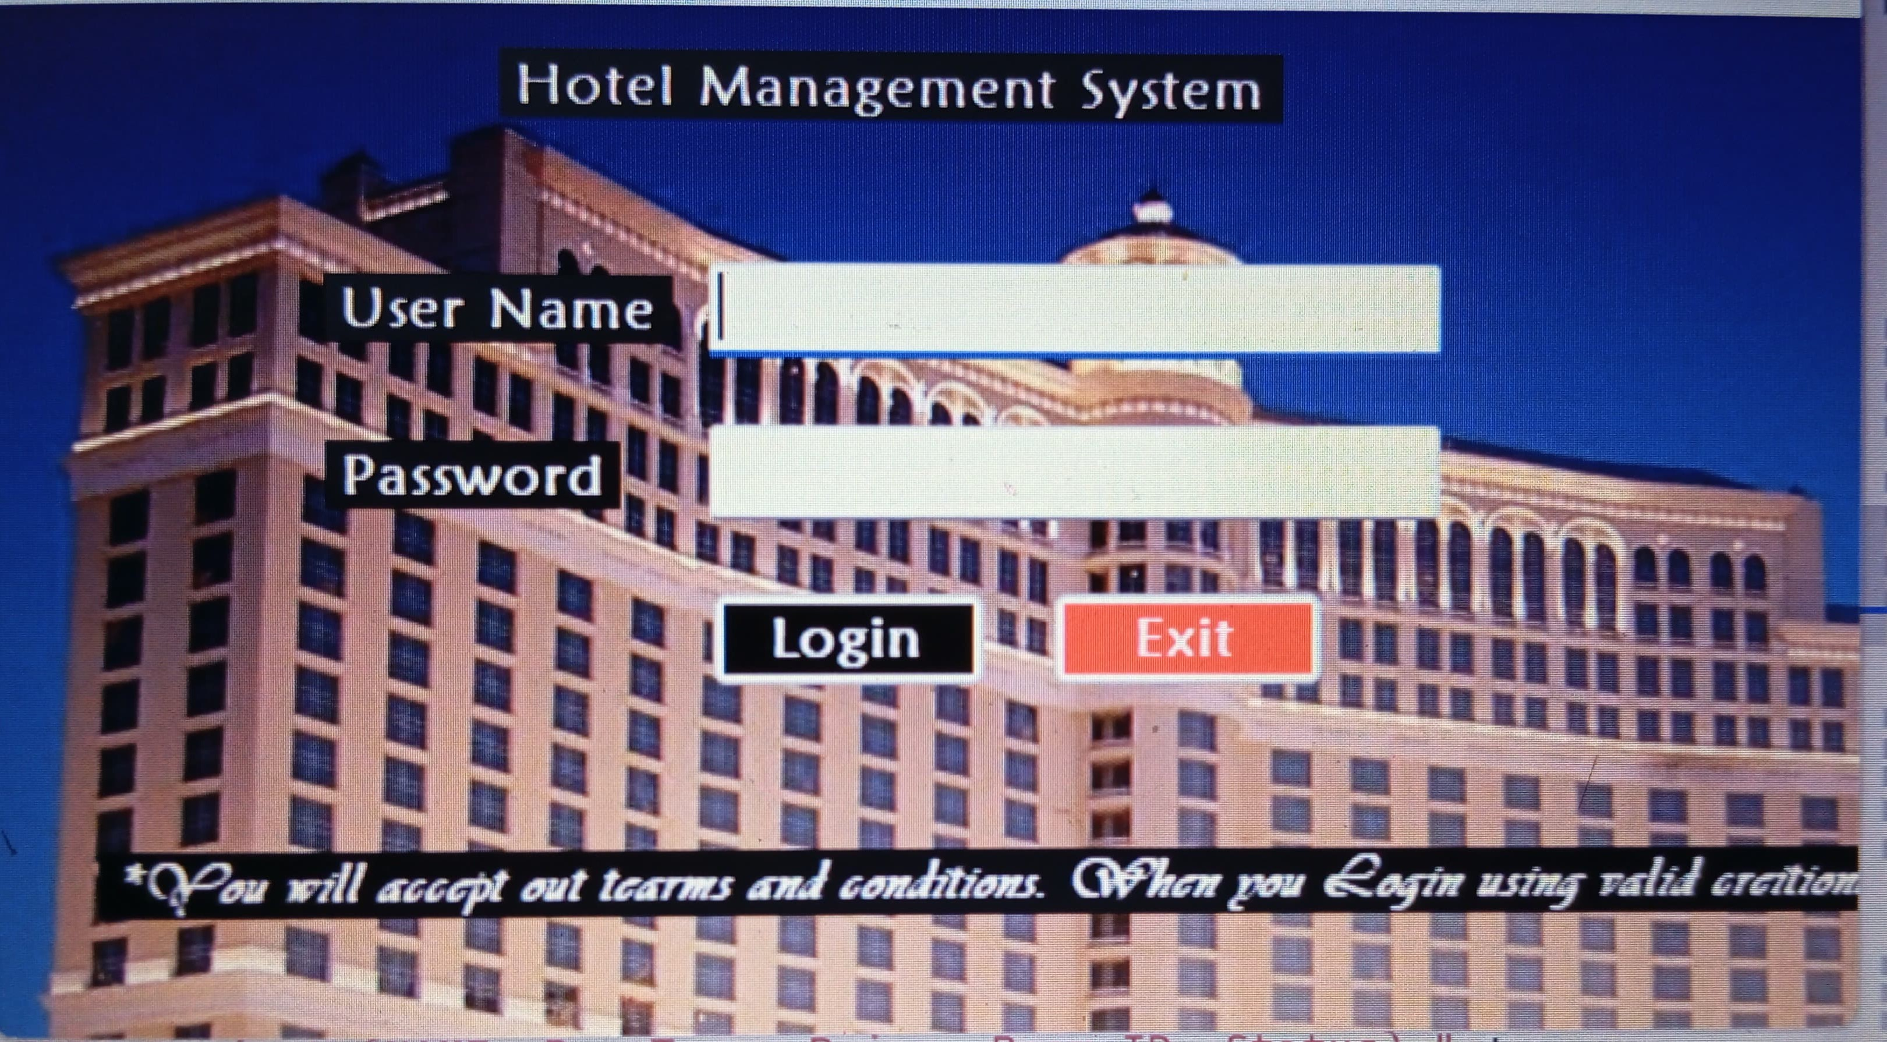
Basic functionality
This “hotel management system” is made in C# language on .net framework by using the IDE of visual studio . My SQL server and MSAcess
is used for the data base .
It has a login page that is used to provide access only
to authorized users .

Slide 4

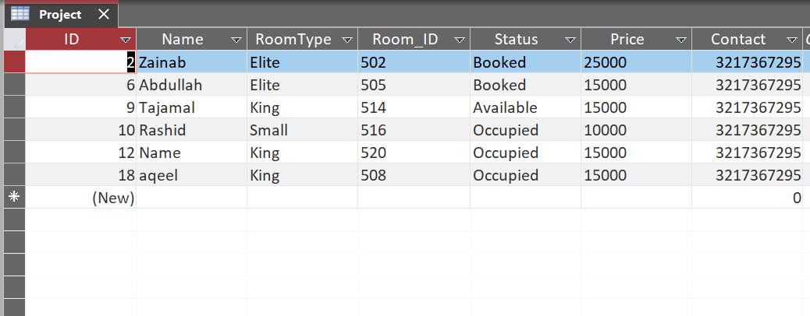
Basic functionality
My SQL server is used and Database is made in MS ACESS . The queries of INSERT , DELETE , UPDATE , SELECT .
Prices of rooms are automatically shown in text boxes
when the client select his desired room.
Each room has a unique id that is assigned it and on dashboard there is maintained & updated data
that how many rooms in the hotels are
currently booked and how many remain.

Slide 5
FEATURES :
Basic features includes :
Login page
Dashboard
Rooms
Categories
Booking

Slide 6



Rooms categeories
it book room for clients. The rooms inside this hotel management system are of three types
SMALL (Rs10000)
KING (Rs15000) ELITE (Rs25000)

